Slide 1


Customer Sentiment and Trend Analysis
This presentation will introduce our Sentiment Analysis project, highlighting its objectives, methodologies, and potential impact.

Slide 2




Omnia Ahmed Hussein
omniameabed@gmail.com
Alaa Sayed AbdulKareem
alaausayed@gmail.com
Omnia Samir Sediq
samiromnia83@gmail.com
Asmaa Mohamed Ali
asmaamohamedali56@gmail.com
Rana Yasser Anter
rasamm313612@gmail.com

Slide 3


01
Project Overview
We conducted sentiment and trend analysis on the Amazon Review Dataset using machine learning models like Logistic Regression, SVM. After data preprocessing, we classified reviews into positive and negative sentiments and analyzed trends over time to provide insights into customer feedback and product performance.

Slide 4

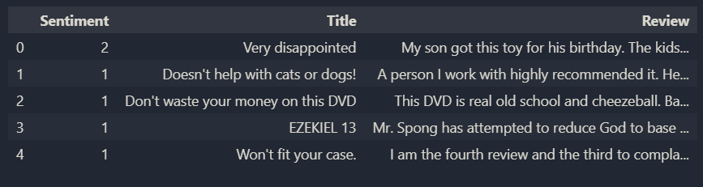
02
Dataset
The dataset used in this project is the Amazon Reviews Dataset which has 20000 sample. The dataset includes the following columns:
Sentiment: The target variable indicating the sentiment of the review (0 for negative, 1 for positive)
Title: A brief summary or title of the review.
Review: The full text of the customer's review.

Slide 5




03
Methodology
Data Collection
Preprocessing
Model Selection
Gather relevant data from diverse sources.
Clean, normalize, and engineer data.
Choose and train ML/DL algorithms for peak performance.

Slide 6
04
Data Collection and Preprocessing
We gather relevant datasets from various sources and clean, normalize, and preprocess the data to ensure its quality and consistency. This step is crucial for training accurate and reliable AI models.
The data was cleaned and preprocessed to remove noise, such as HTML tags, punctuation, and stopwords. This involved:
Tokenization
Lemmatization
Handling of contractions and special characters

Slide 7
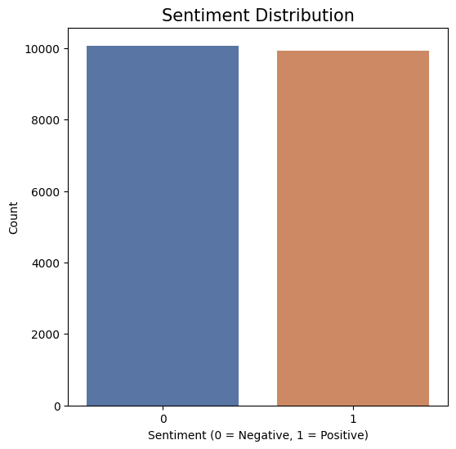
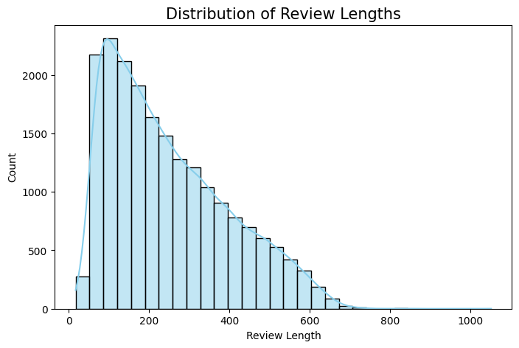
Exploratory Data Analysis (EDA)
05
We performed EDA to visualize the distribution of sentiments, identify trends, and understand the dataset better. This included:
frequency of positive and negative reviews
Review Length Distribution

Slide 8
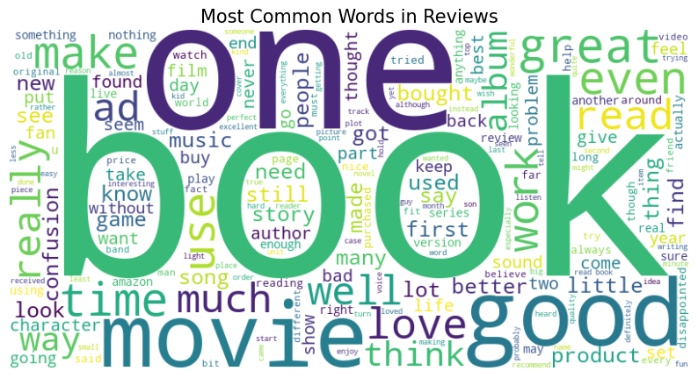
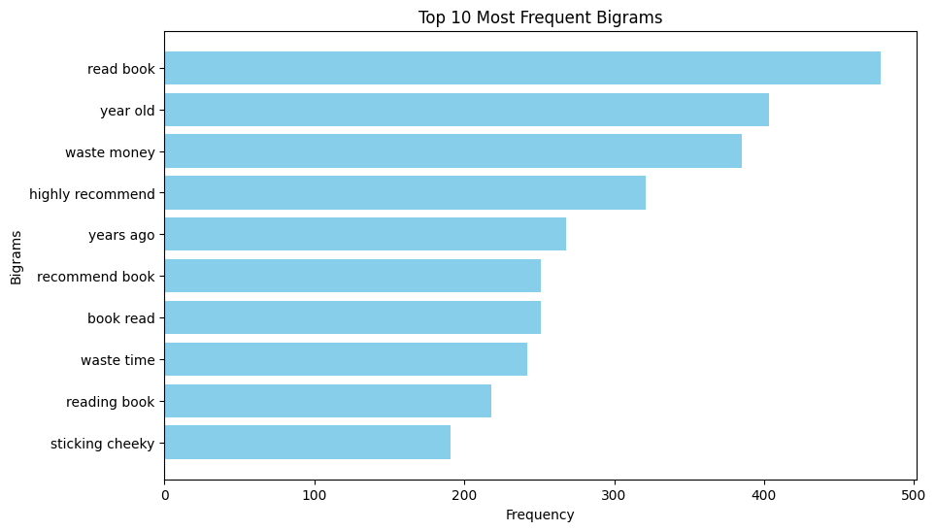
Exploratory Data Analysis (EDA)
06
Word Cloud for Frequent Words
Bi-gram Frequency

Slide 9



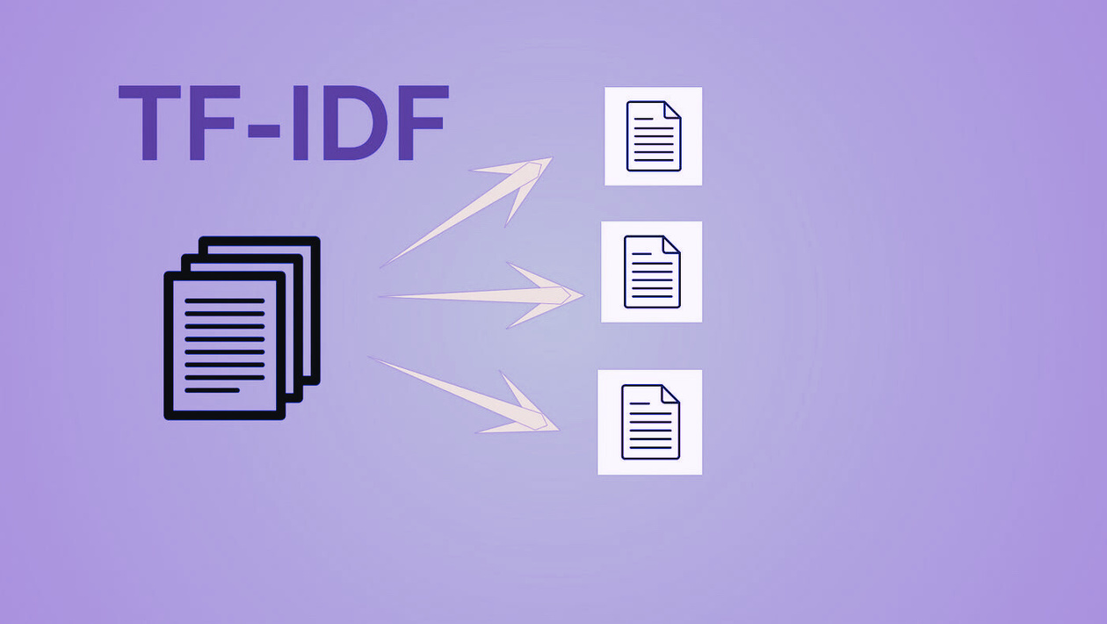
07
Feature Engineering
Utilized TF-IDF vectorization to convert the review texts into numerical representations suitable for machine learning models.

Slide 10

08
Model
Development
We experimented with various machine learning algorithms, including:
Logistic Regression
Random Forest
Support Vector Machine (SVM)
Decision Trees
XGBoost

Slide 11


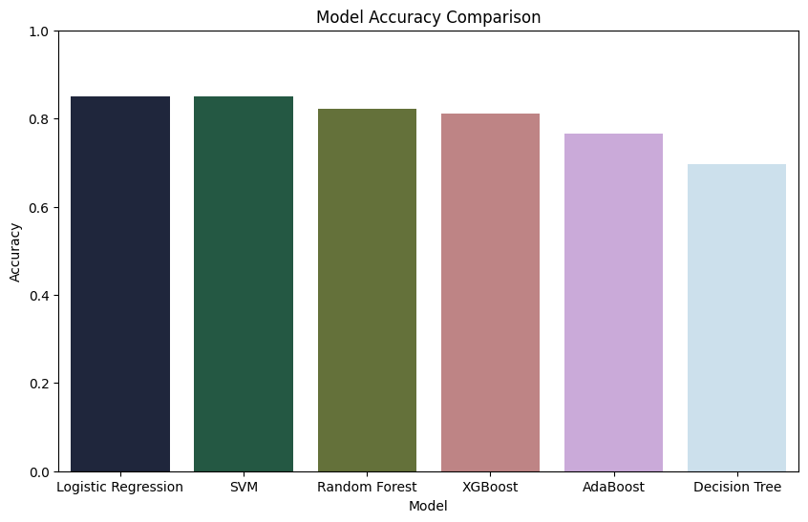
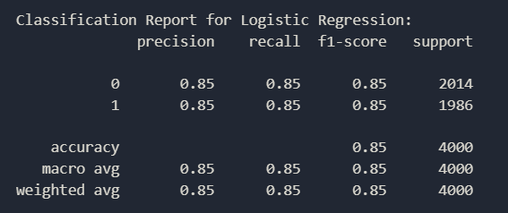
Evaluation Metrics
09
The performance of each model was evaluated using accuracy, and classification reports. We selected the best-performing model based on these metrics.

Slide 12
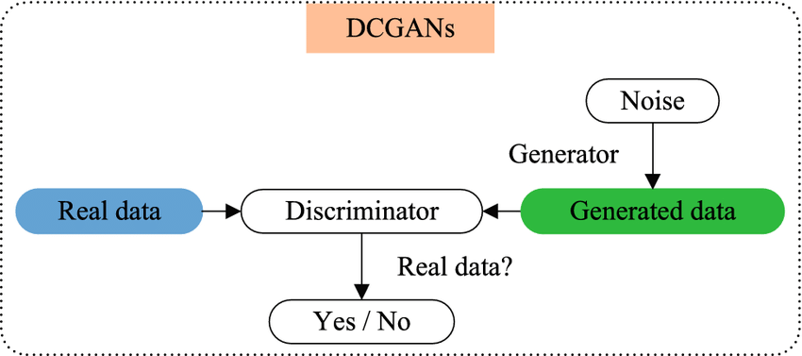
GANs Model
10
Generative Adversarial Networks, or GANs, are a revolutionary type of neural network architecture introduced by Ian Goodfellow in 2014. They consist of two competing models: a generator and a discriminator.
The generator is tasked with creating new data samples, while the discriminator's job is to evaluate whether the generated samples are real or fake, based on a dataset of real examples.

Slide 13
GANs Model
11
improve sentiment analysis by generating high-quality text samples that can augment training data.
Text is discrete, unlike continuous image pixels, which makes text generation more challenging.
The project involves several key steps:
Data Preparation: Load and preprocess Amazon review data.
Text Tokenization: Convert text into numerical sequences.
Embedding Layer: Utilize pre-trained embeddings for better representation.
GAN Architecture: Construct and train a GAN model for text generation.
Text Generation: Generate synthetic text from trained models.

Slide 14
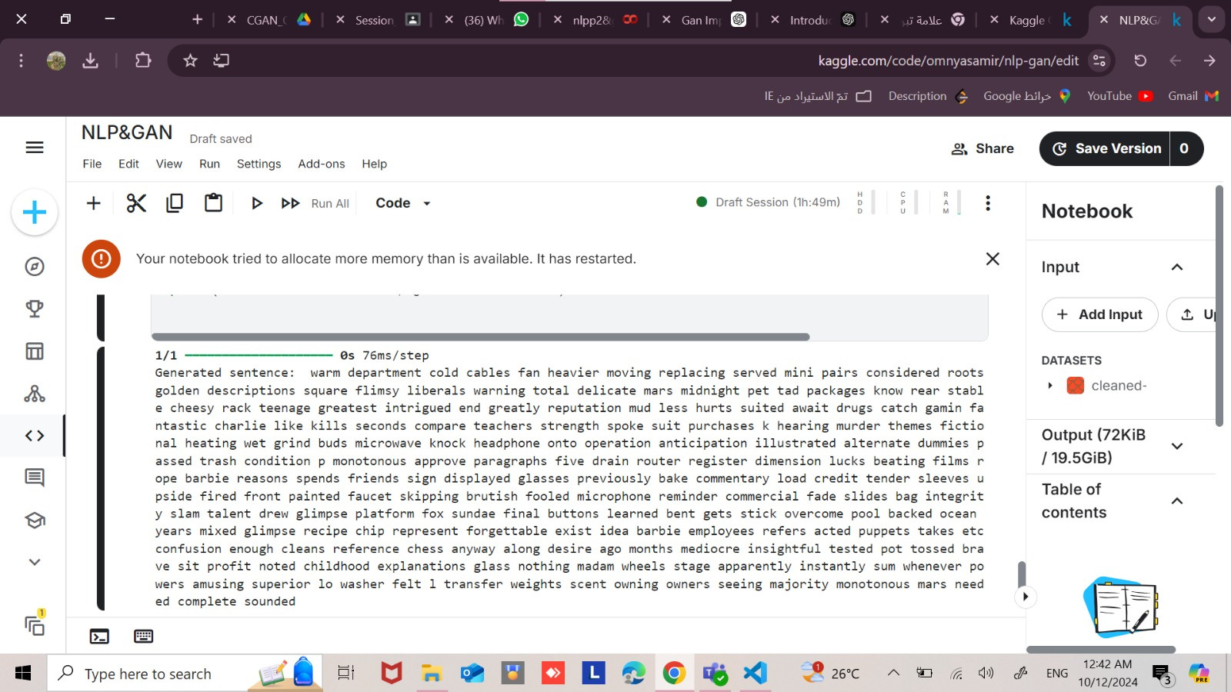
12
Text Generation:

Slide 15

13
Data Collection and Preprocessing
The IMPORTFROMWEB library allows users to pull data from Amazon product pages directly into Google Sheets
Allows for more advanced web scraping capabilities compared to standard functions.
Ideal for analyzing customer feedback and ratings.
Sentiment Analysis: Gauge customer sentiment through review text.
With =IMPORTFROMWEB(), you extract the following data points from Amazon reviews pages:[ review title-rating-profile name-review body]

Slide 16
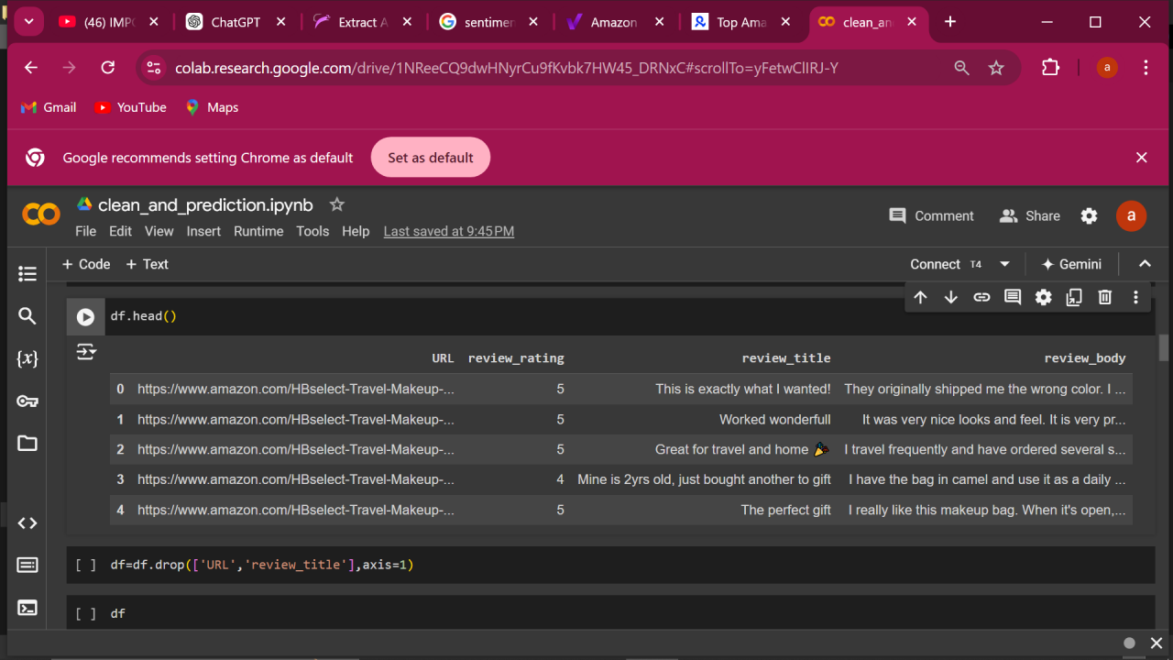
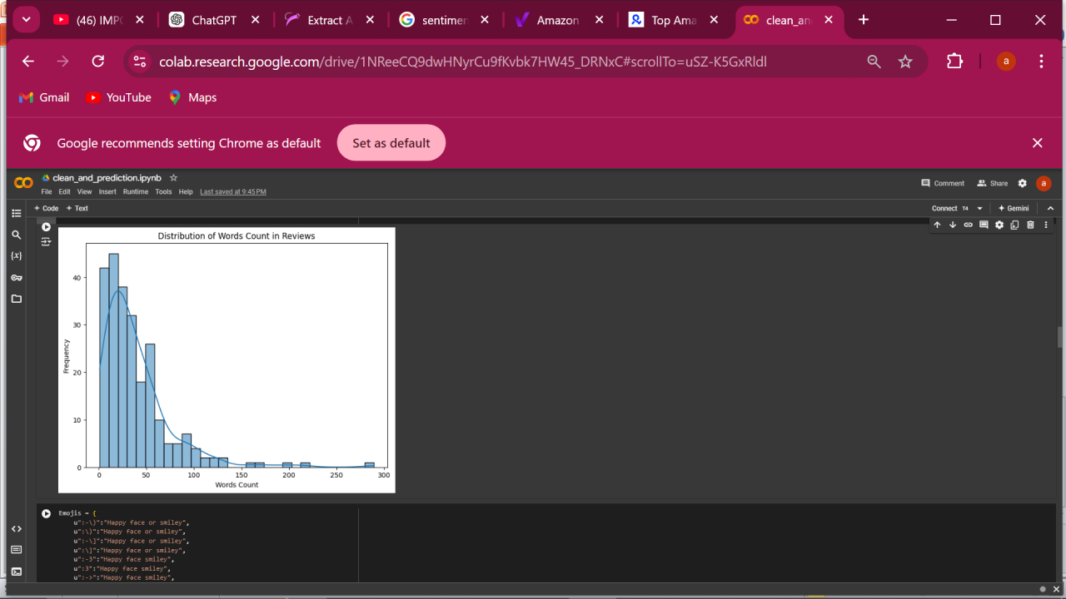
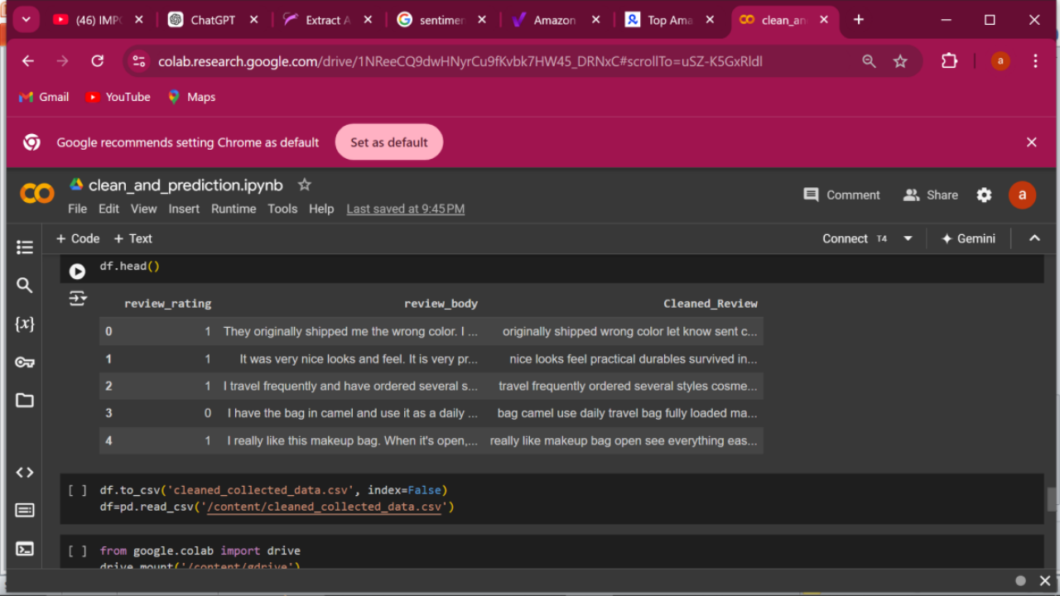
14
Sample of collected data
Cleaned this data for prediction

Slide 17

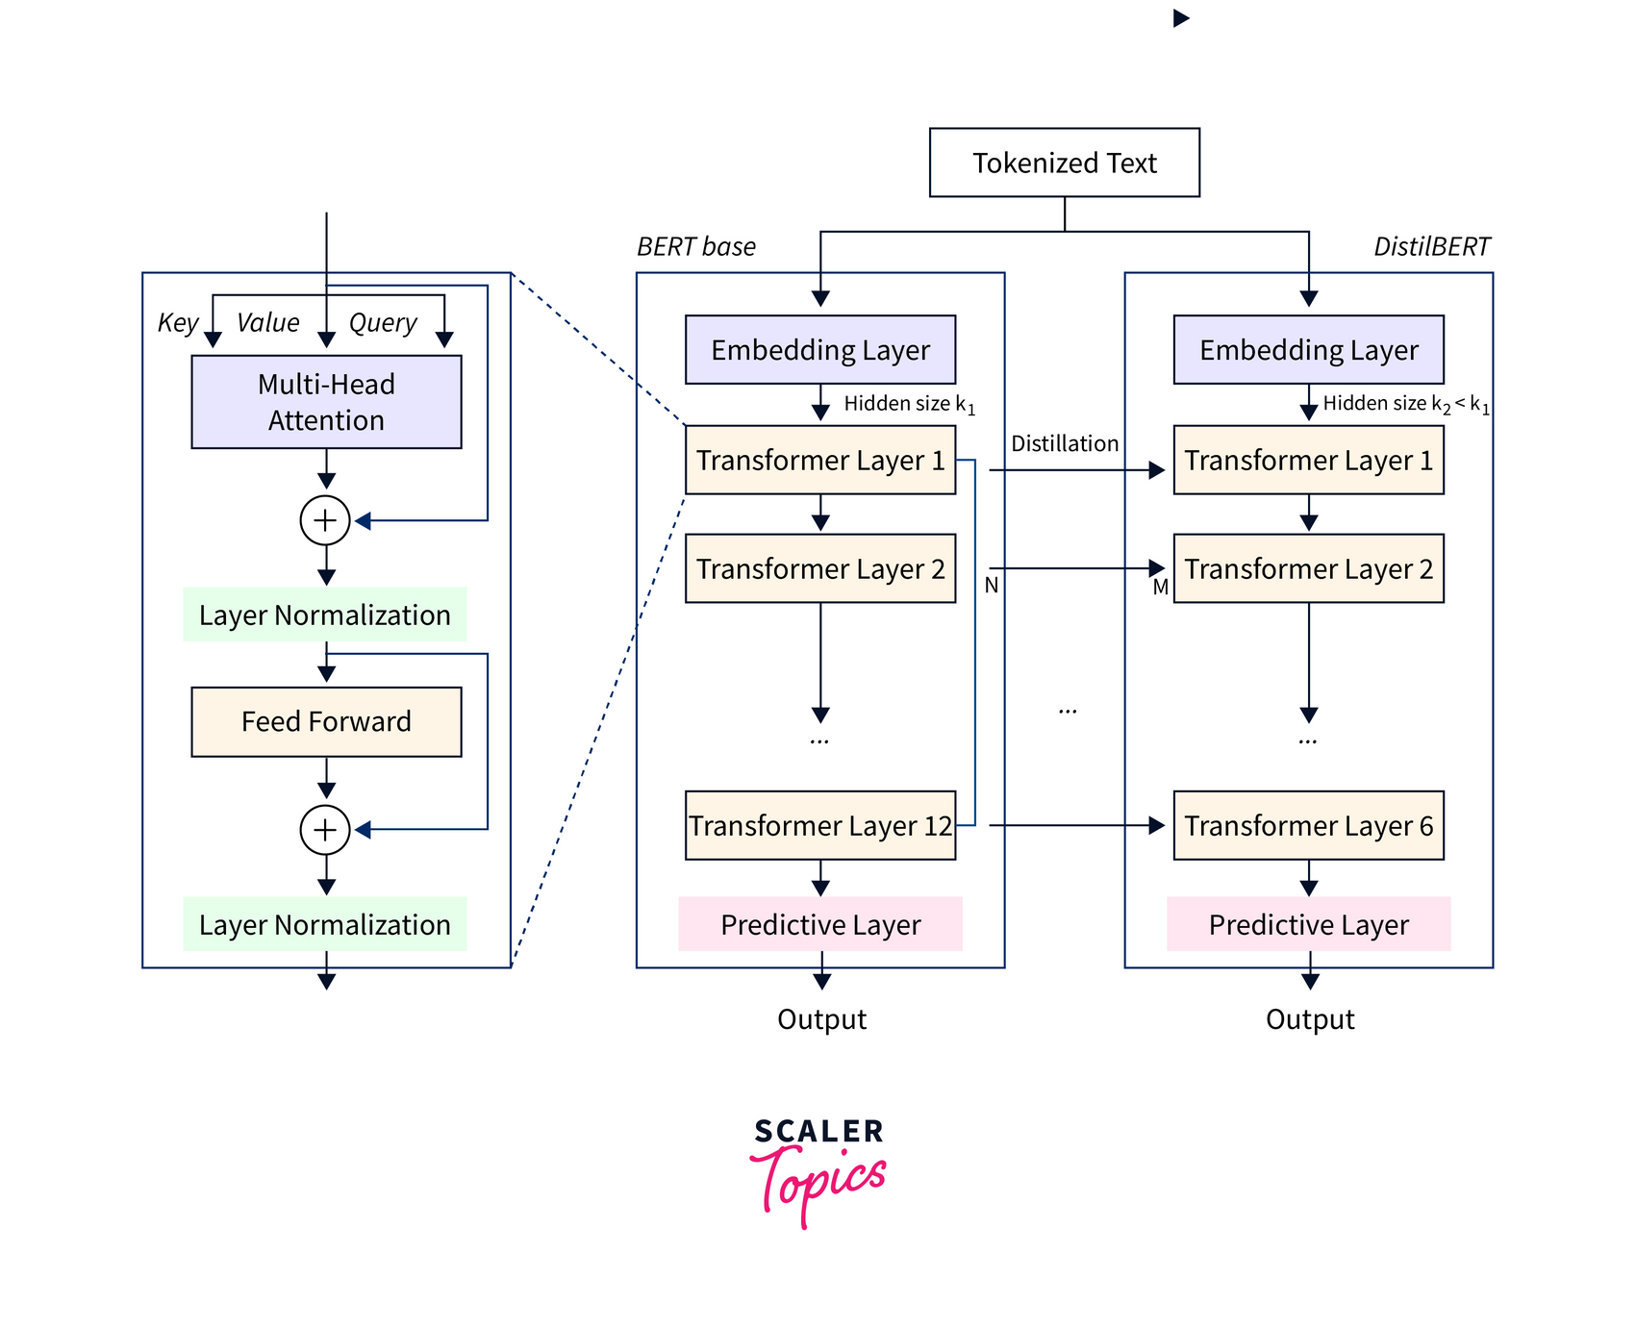
Fine tune using DistilBERT
15
DistilBERT is a smaller, faster, and lighter version of the BERT (Bidirectional Encoder Representations from Transformers) model.
It was developed by Hugging Face and is designed to retain much of BERT's performance while being more efficient in terms of speed and resource usage.
It retains approximately 97% of BERT's language understanding capabilities while having about 60% fewer parameters. This results in significantly faster inference times.
It consists of fewer transformer layers (6 layers vs. BERT’s 12), making it computationally less intensive.
10

Slide 18
Fine tune using DistilBERT
16
Ideal for real-time applications where latency is critical, such as chatbots and online sentiment analysis.
Requires less memory and computational power, making it accessible for deployment on devices with limited resources.
DistilBERT can be fine-tuned on specific datasets using techniques like transfer learning, allowing it to adapt to specialized tasks efficiently.
Use Cases : Amazon Reviews Sentiment Analysis
Total Reviews: 20,000 Amazon reviews
.Labeling: Each review is paired with a sentiment label (positive or negative).
Model Hyperparameters
Training Epochs:
train_epochs = 5
The model is trained for 5 epochs to ensure convergence and minimize overfitting.

Slide 19
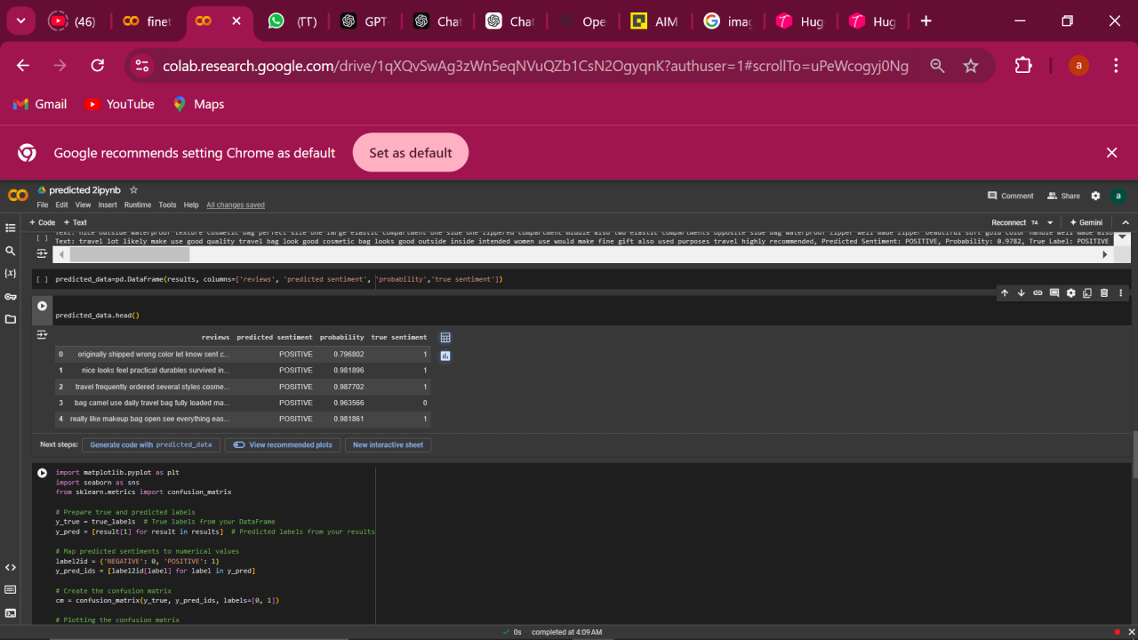
Fine tune using DistilBERT
17
Weight Decay:
weight_decay = 0.01
Regularization technique to prevent overfitting by penalizing large weights.
Early Stopping:
early_stopping_patience = 3
If validation performance doesn’t improve for 3 consecutive epochs, training is halted to avoid overfitting.
Performance:
Accuracy; 85% - F1 : 85%
Training Loss : 0.14 - validation loss : 0.63

Slide 20
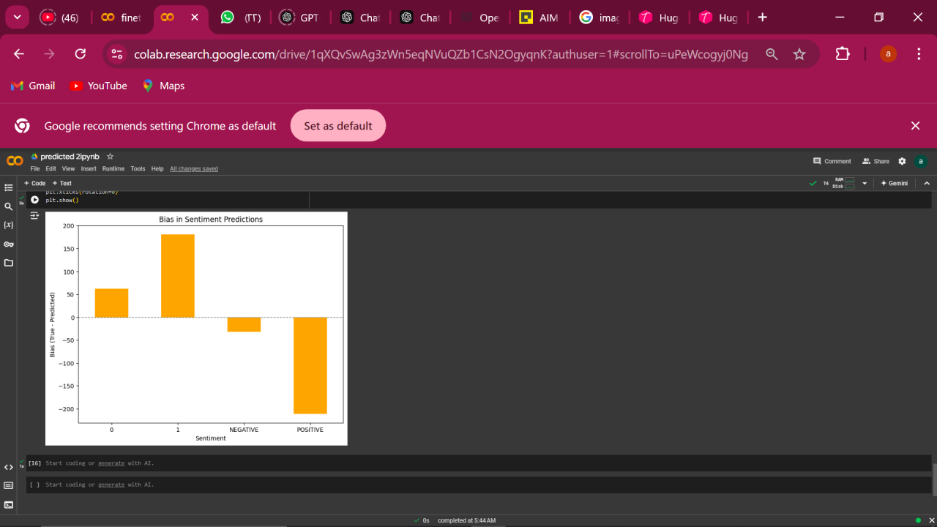
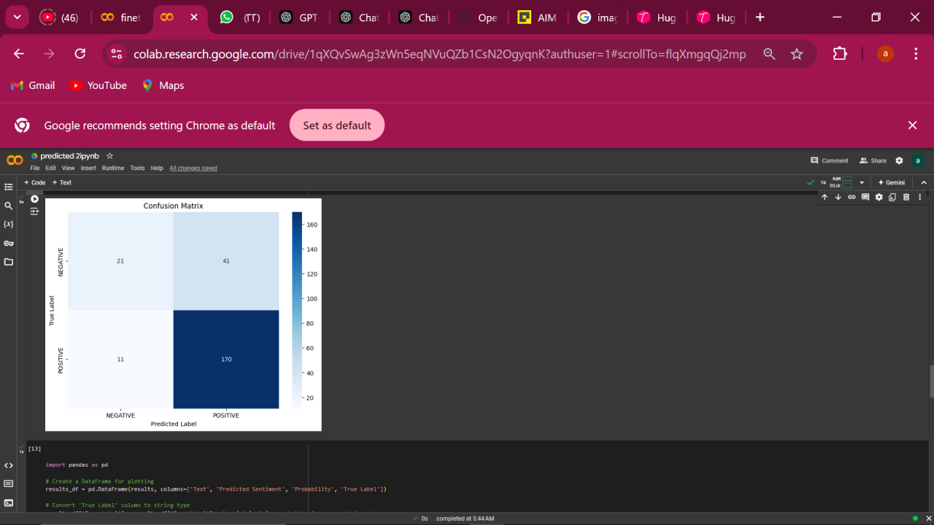
Fine tune using DistilBERT
18
10

Slide 21
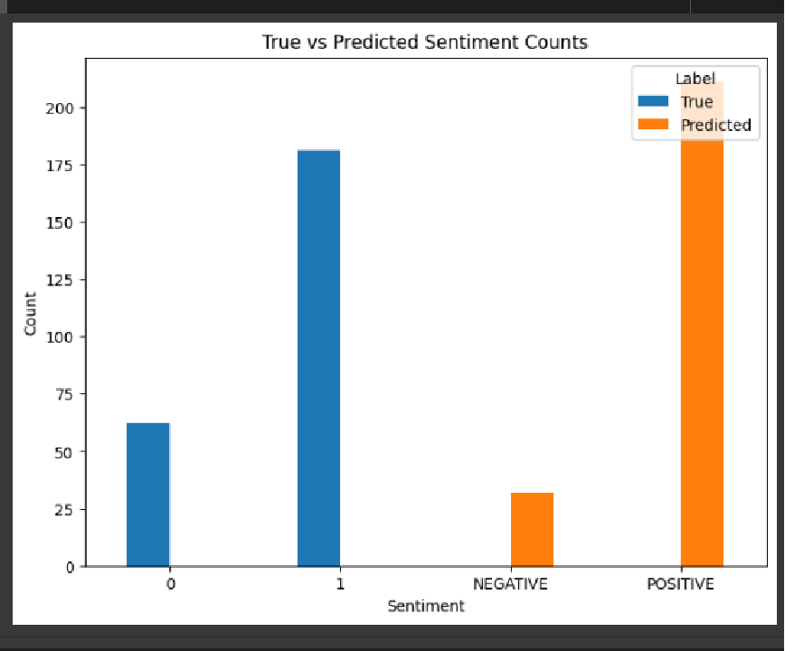
Fine tune using DistilBERT
19
10

Slide 22
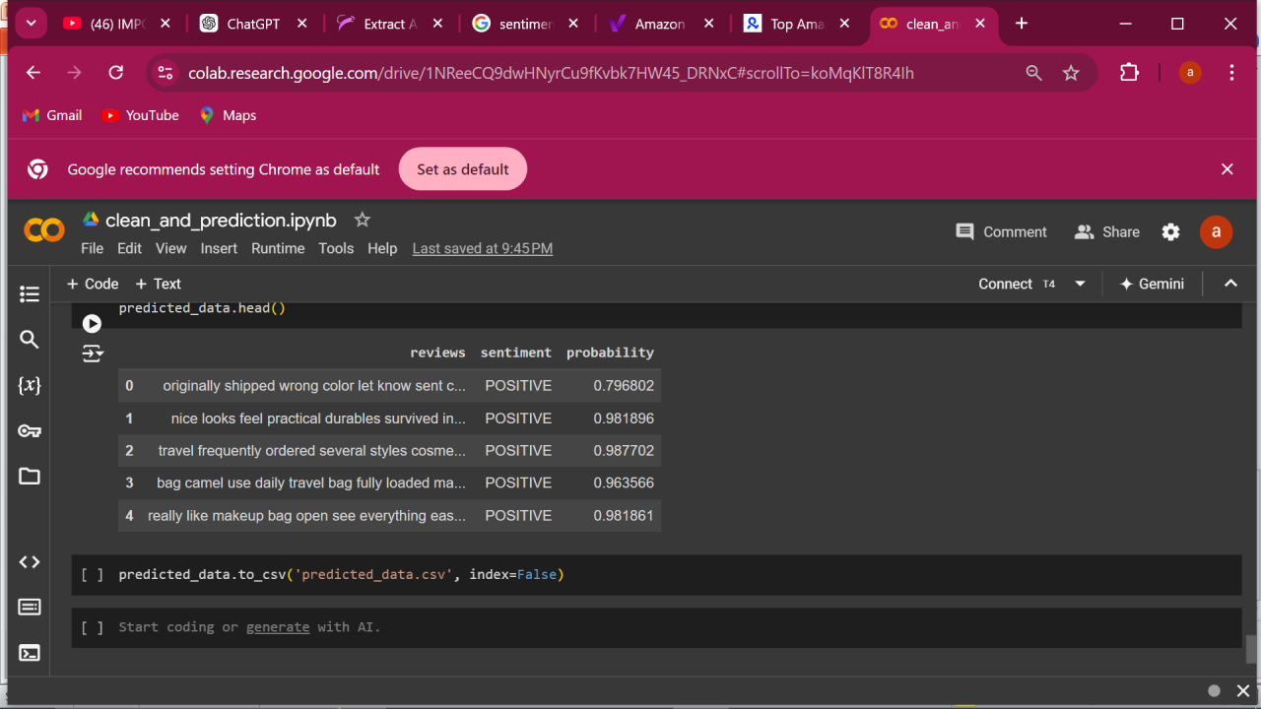
20
Cleaned this data for prediction
Predicted data from DistilBERT

Slide 23

21
What is MLFlow?
Why MLFlow?
How we used it?

Slide 24
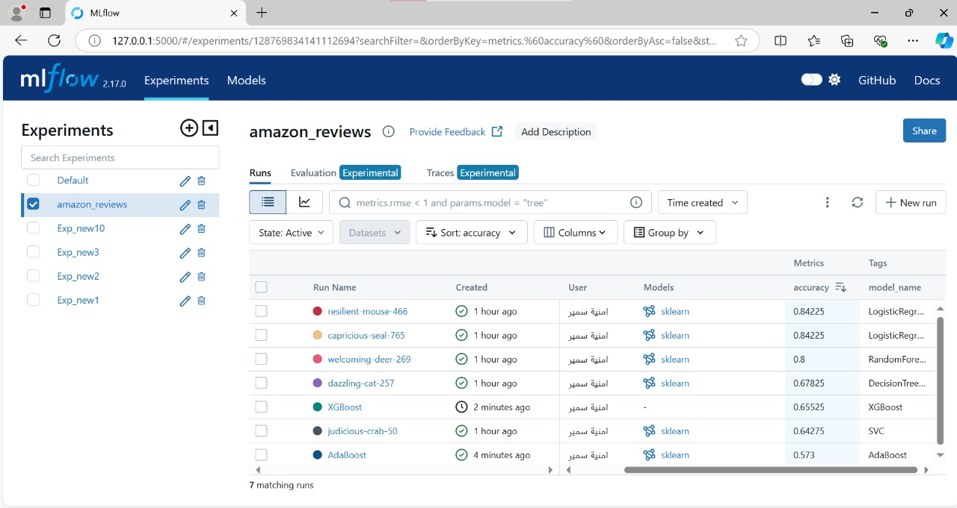
MLflow
22

Slide 25
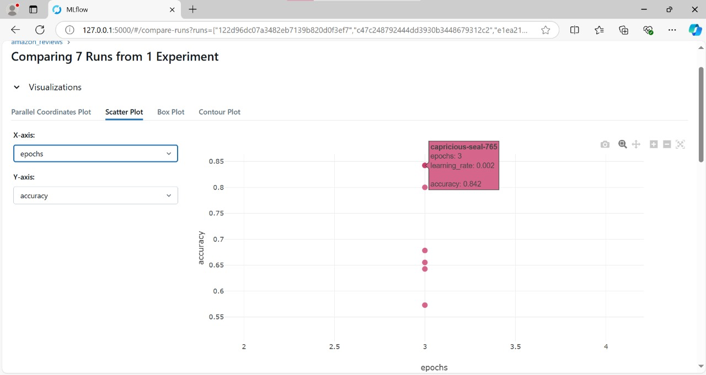
MLflow
23

Slide 26
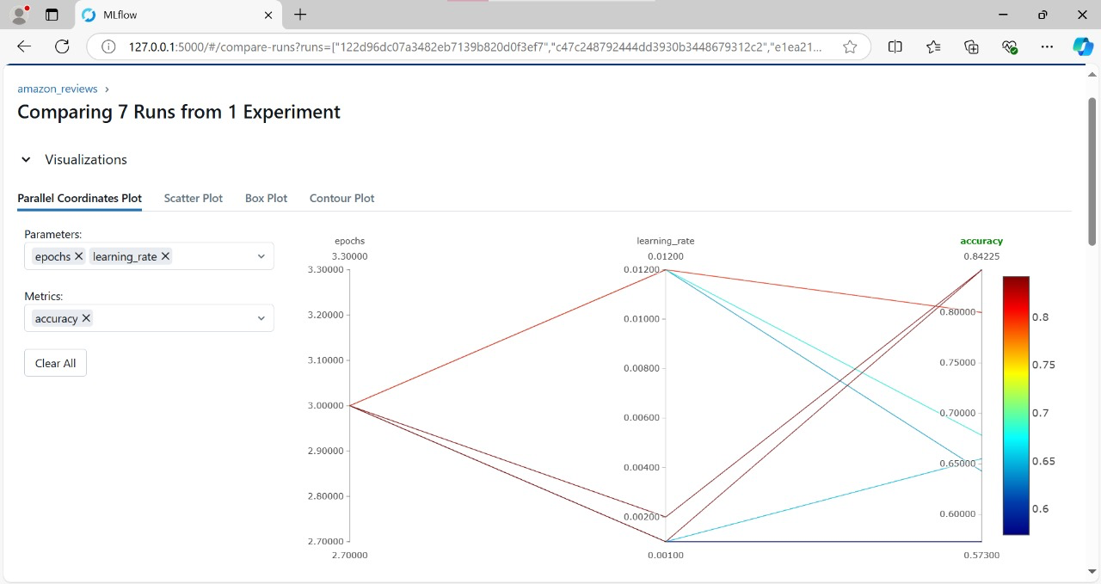
MLflow
24

Slide 27
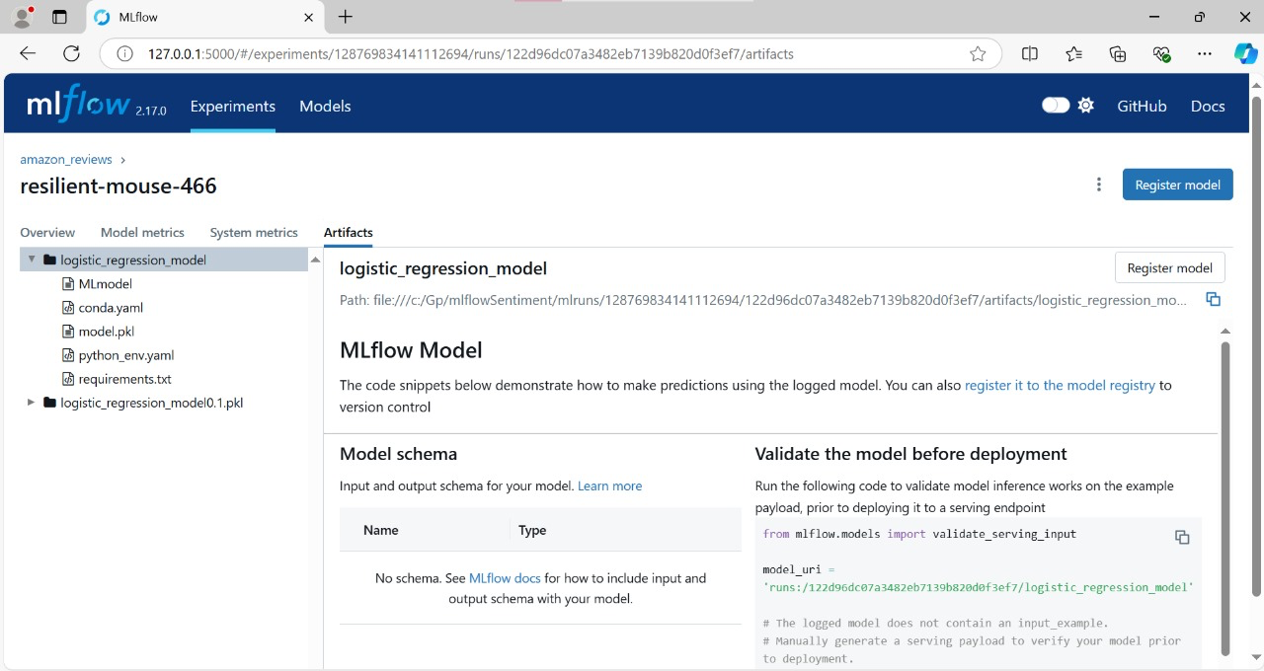
MLflow
25

Slide 28
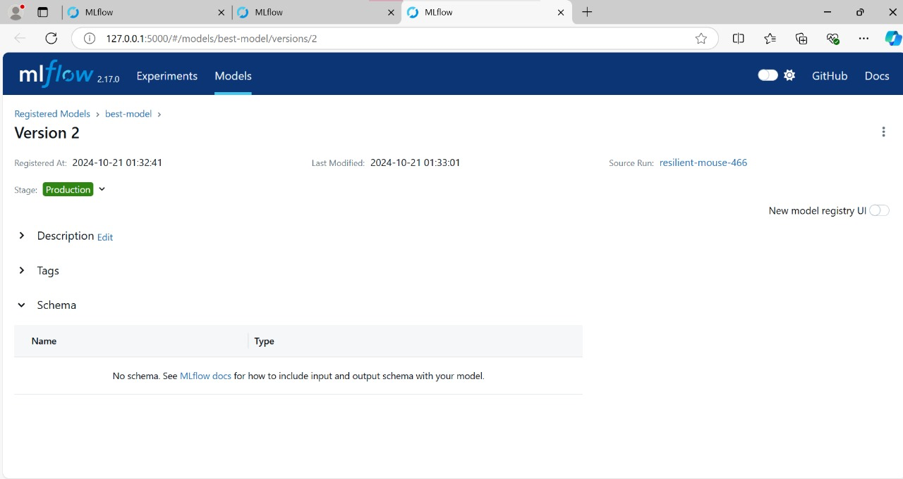
MLflow
26

Slide 29
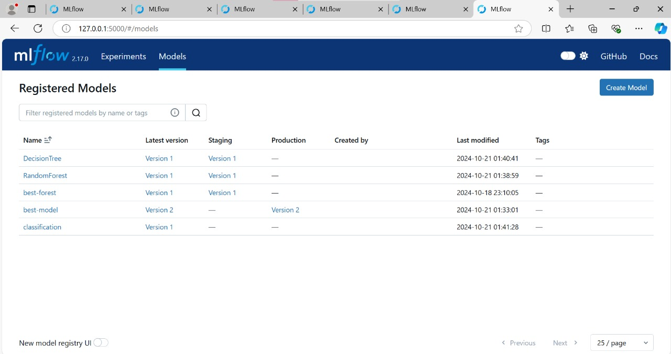
MLflow
27

Slide 30

Deploying Machine Learning Models on Azure
28
What is Azure?
Why Azure?
How we used it?

Slide 31
Deploying Machine Learning Models on Azure
29
Utilize Logistic Regression to build and train a machine learning model for classifying Amazon reviews based on sentiment (positive/negative).
Implement MLFlow and deploying it using Azure Machine Learning Studio.
Deploy the trained model in Azure Machine Learning Studio to provide an API endpoint

Slide 32
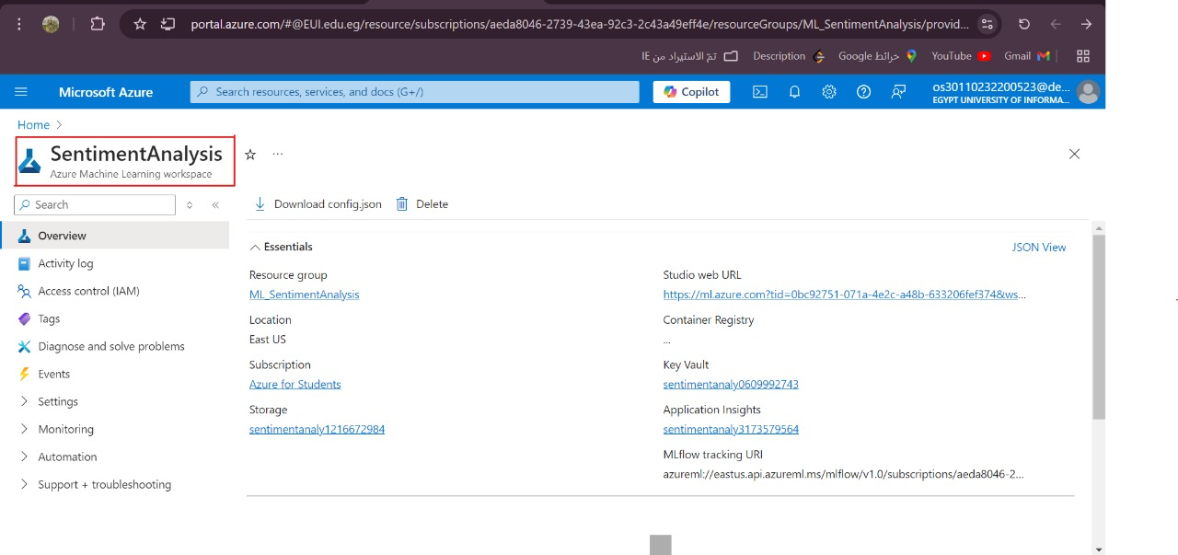
Steps for Model Deployment Using Azure:
30
1. Create a Workspace:
Start by creating a workspace in Azure, where all your activities related to machine learning will take place.

Slide 33
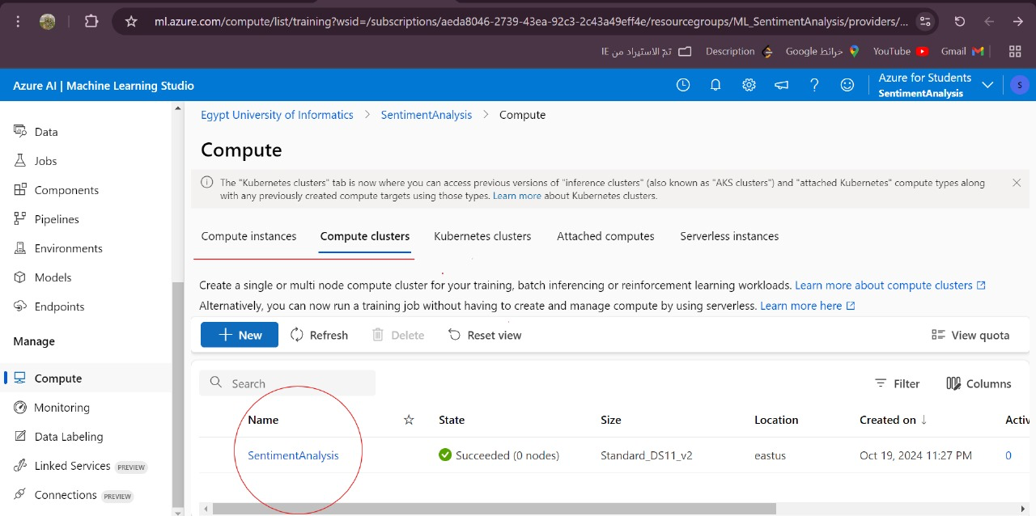
Steps for Model Deployment Using Azure:
31
2. Set Up Compute Resources:
Choose the virtual machine (VM) or set up a cluster of machines to handle training or deployment.

Slide 34
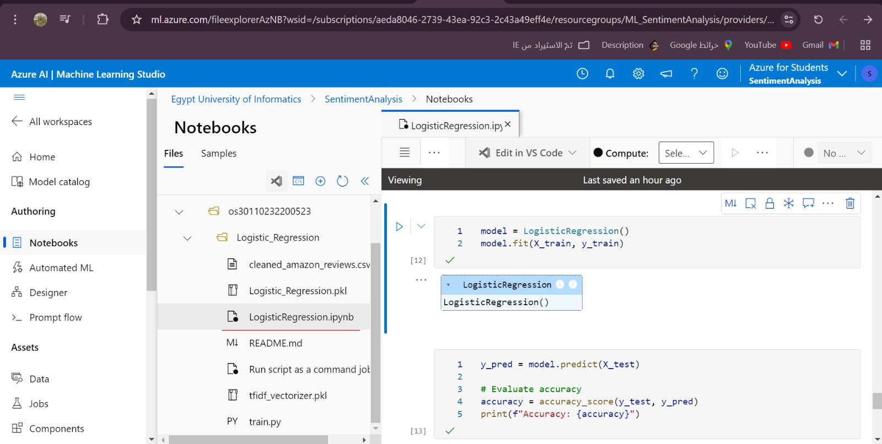
Steps for Model Deployment Using Azure:
32
3. training the model

Slide 35
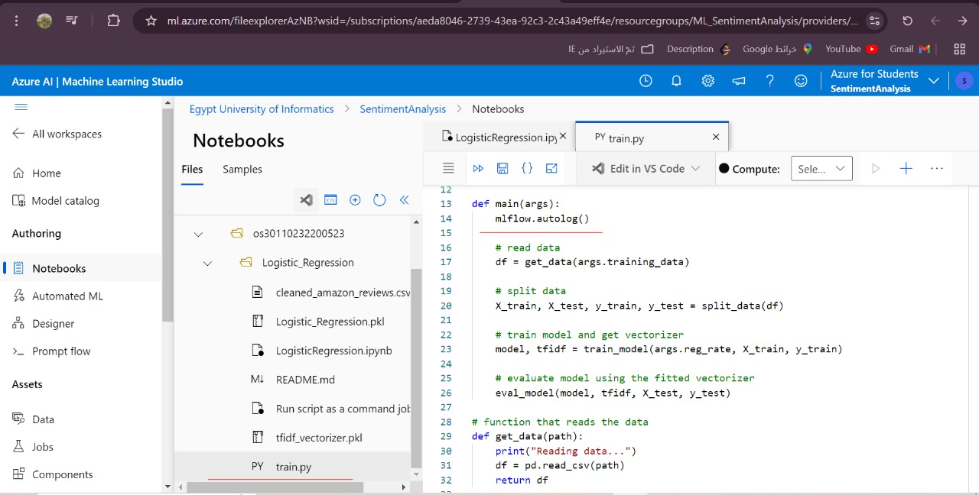
Steps for Model Deployment Using Azure:
33
3. training the model

Slide 36
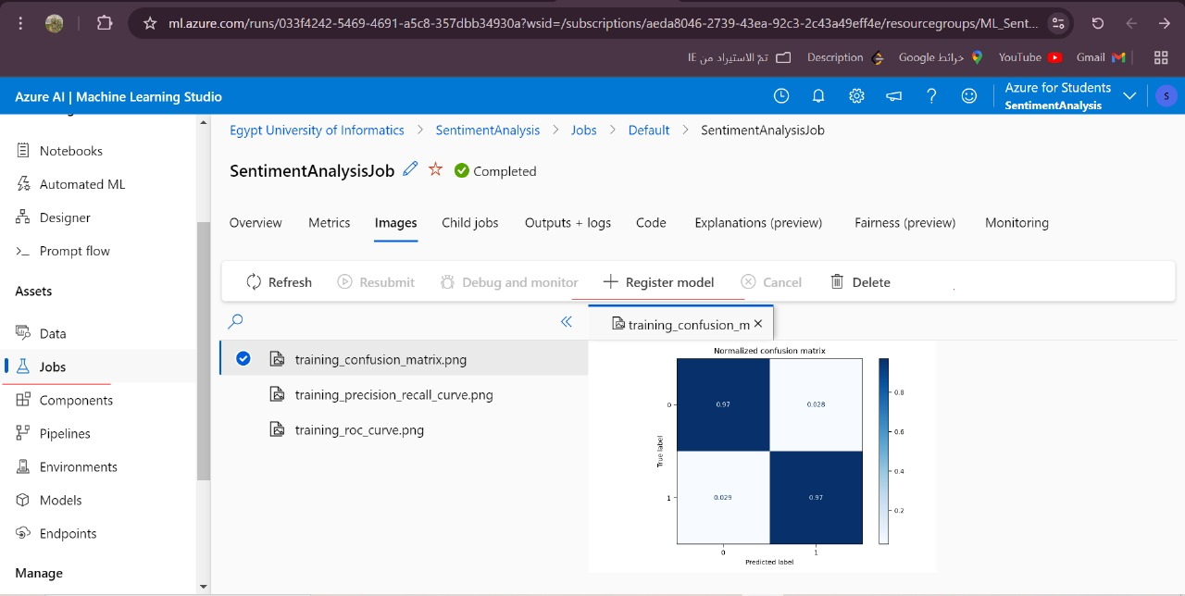
Steps for Model Deployment Using Azure:
34
4. Register the Model:
the Model Registry to make it ready for deployment.

Slide 37
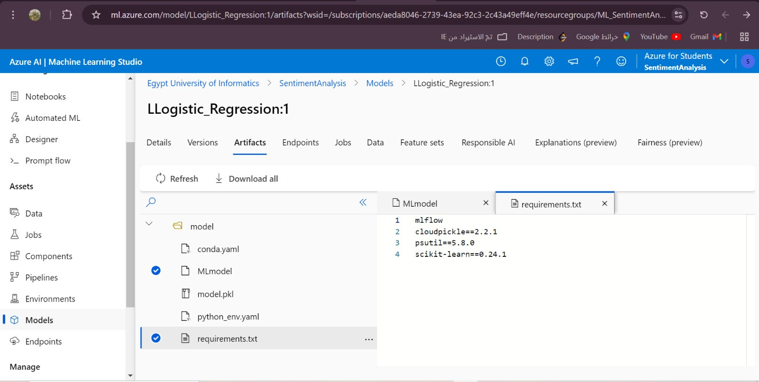
Steps for Model Deployment Using Azure:
35
4. Register the Model:
the Model Registry to make it ready for deployment.

Slide 38
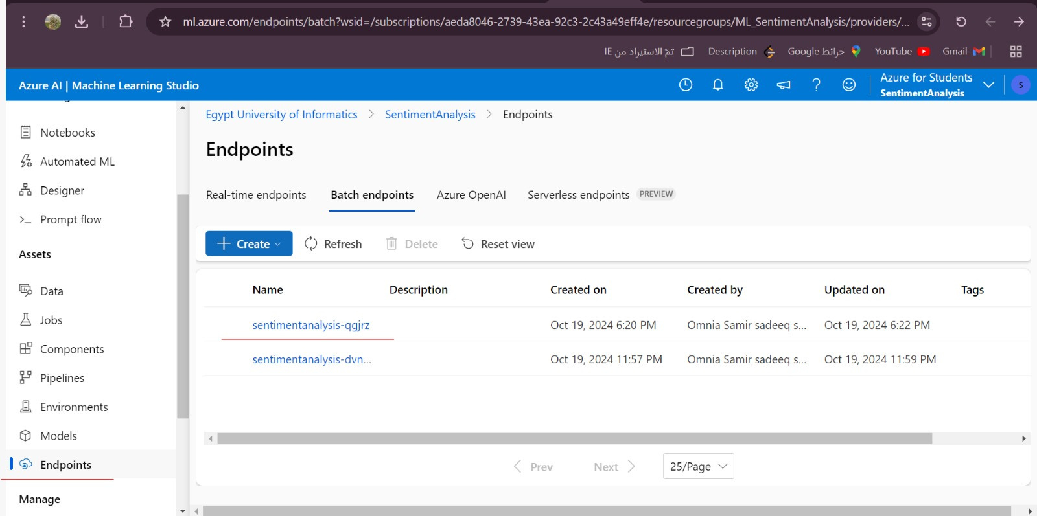
Steps for Model Deployment Using Azure:
36
5. Create an Endpoint:
This is the API through which external applications can interact with your model.

Slide 39
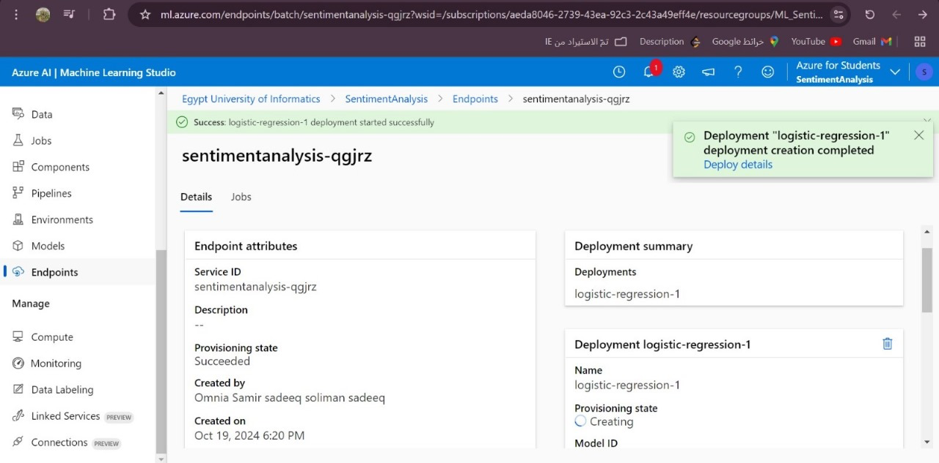
Steps for Model Deployment Using Azure:
37
6. Deploy the Model:
Your model is now available for API calls.

Slide 40
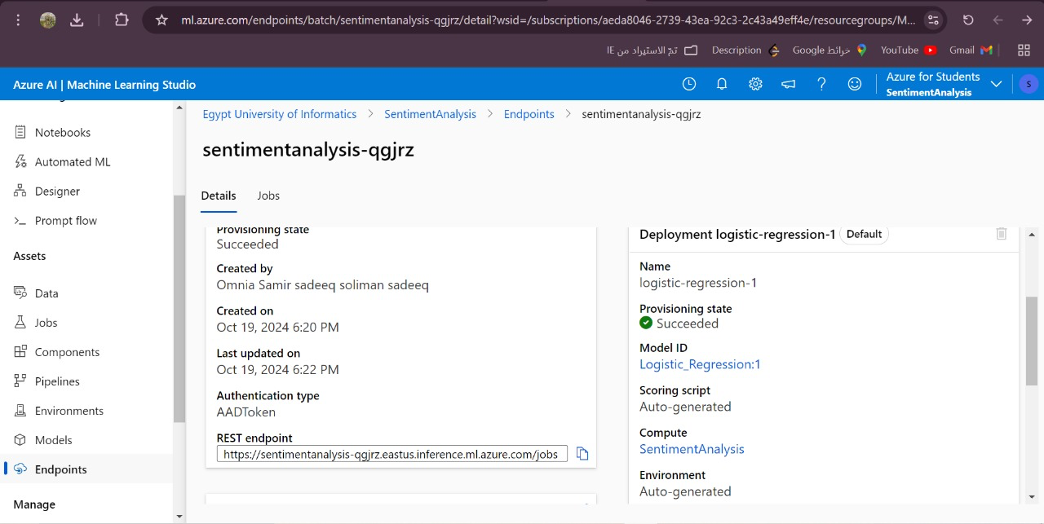
Steps for Model Deployment Using Azure:
38

Slide 41
Thank You!

